Slide 1

FEATURES
94 Holidays and memories
Writers return to their roots
96 Walking for wildlife
Mike Fay: a personal approach to saving wild places
98 All aboard!
A report on global tourism
102 Questions and answers
A video about National Geographic Explorers’ lives
Unit 8-p. 93

Slide 2
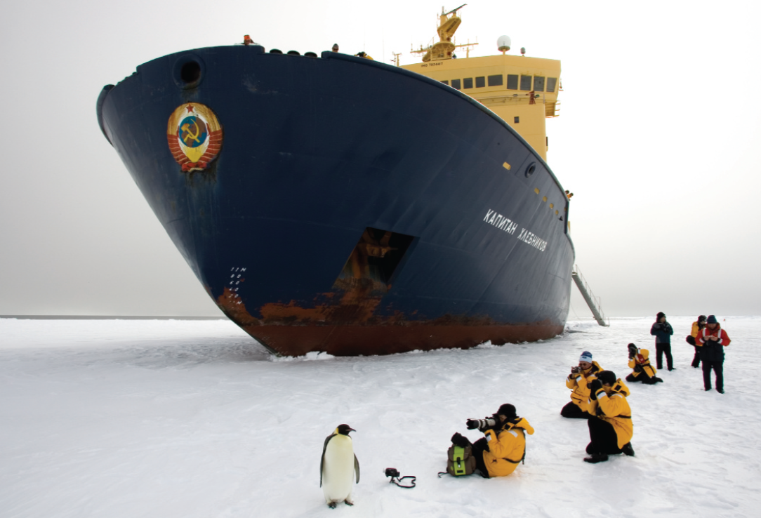
1 Work in pairs. Look at the photo. Discuss the questions.
1 What kind of holiday do you think this is? Why?
2 Do you think the people do this kind of trip often? Why? / Why not?
3 Would you like to take a trip like this?
Tourists take photos of an emperor penguin on the frozen Amundsen Sea in Antarctica.
EXAMPLE ANSWERS
1 It looks like a research trip or a holiday in Antarctica where tourists see and photograph wildlife. The people are wearing warm weather gear and have state-of-the-art cameras so it suggests a very specialist tourist trip.
2 No, it’s probably a once in a lifetime trip. It’s a long way to travel and must be very expensive. Conditions might be difficult or dangerous.
3 Students’ own answers
Unit 8-p. 93

Slide 3
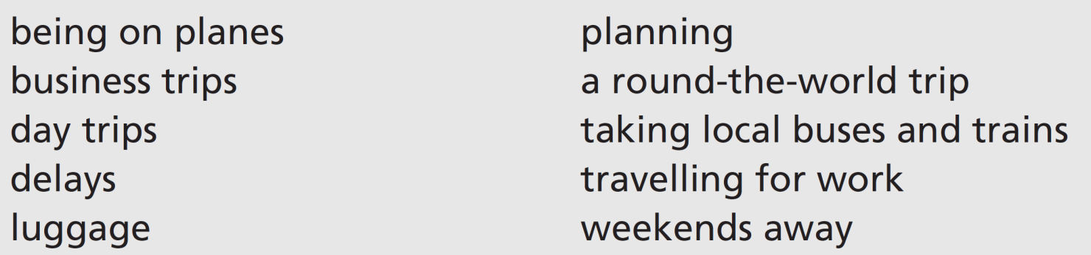
2 Listen to three people talking about travel. Write the number of the speaker (1–3) next to the things they talk about.
3
1; 2
3
1
2
1
3
3
1
2
3 Listen again. Each speaker shares a travel tip. What are their tips? Discuss the tips with your partner.
Track 61
Speaker 1: Just take a small backpack with the essentials.
Speaker 2: The key to a good trip is good planning. Don’t leave anything to chance!
Speaker 3: Once the flight starts, take your watch off and relax. You have no control over the time you arrive, so why get stressed?
Unit 8-p. 93

Slide 4
Script
Track 61
1
A couple of years ago I went on a round-the-world trip with a friend. What an experience! The best bits were when we took local buses and trains – you know the kind of thing. They stop everywhere and it takes ages to get to where you’re going. On the other hand, we met some really interesting people on the buses in Peru. We learned a lot about the history of Peru. But I took far too much luggage with me – I couldn’t carry it easily and I worried about losing it. Just take a small backpack with the essentials, that’s my advice.
2
I haven’t travelled very much in the last few years. I’ve been on a few day trips to Liverpool and I’ve had a couple of weekends away to Scotland this year. I don’t go far any more. I’m more interested in the place I’m going to than in the journey. Edinburgh and Glasgow are fascinating cities. But in my experience, the key to a good trip is good planning. Don’t leave anything to chance!
3
I work in IT and I travel a lot – too much – for my job. I spend a lot of time on planes and in my car on the motorway, travelling to the projects I’m working on. I don’t particularly enjoy it, especially when there are delays, but it’s part of my job. I often get a very early flight from Gatwick and delays can mean I lose a whole working day. I have to go on business trips abroad several times a year. My travel tip? Once the flight starts, take your watch off and relax. You have no control over the time you arrive, so why get stressed?

Slide 5
4 Which countries or cities have you been to? Find people in your class who have had similar experiences to you.
A: Have you been to Vietnam?
B: Yes, we had a holiday there last year.
A: Me too! Where did you go?
Unit 8-p. 93

Slide 6

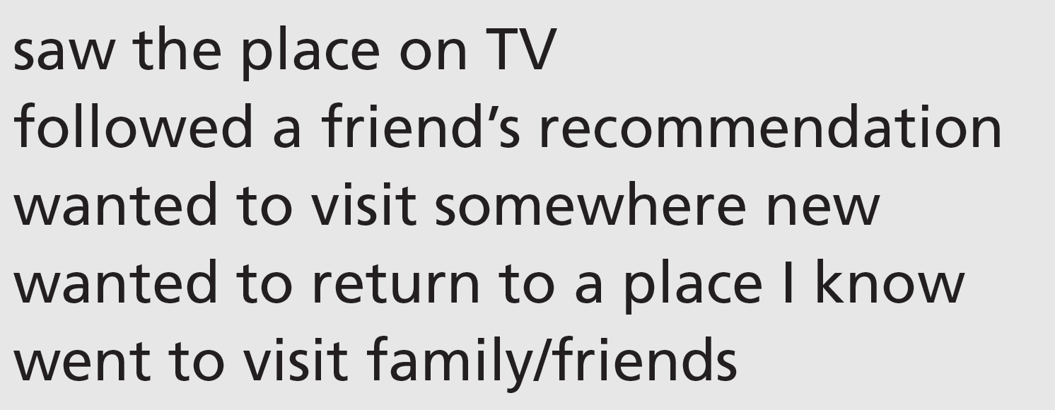
8a Holidays and memories
Vocabulary holiday activities
1 Work in pairs. Why did you choose the destination of your most recent holiday? Tell your partner.
Students’ own answers
8a-p. 94

Slide 7
2 Work in pairs. Match the activities (1–6) with the examples (a–f). What do you enjoy doing when you go on holiday? Give your own examples.
b
f
d
a
e
c
1 taking it easy
2 going sightseeing
3 having new experiences
4 being active
5 learning new things
6 spending time with friends or family
a hiking in the mountains
b lying on the beach
c playing board games
d riding on a camel
e taking a painting course
f visiting famous monuments
8a-p. 94

Slide 8
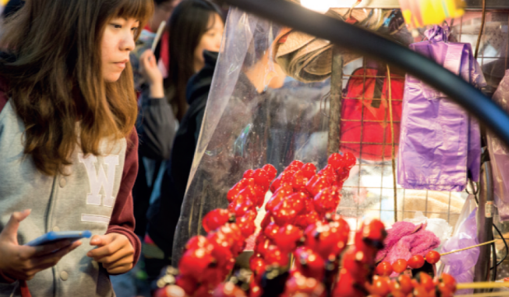
Reading
3 Look at the photo with the article. Which of these things (a– c) do you think it shows?
a a coastline
b a market
c a village
4 Read the article and answer the questions.
1 Where are the writers from and what are their destinations?
2 Which writers haven’t been to these places before?
3 Which writer has problems with the language?
4 Which writer travels with his/her parents?
5 Which writer has to change his/her plans? Why?
8a-p. 94

Slide 9

Track 62
1 Lucy Chang
I step off the train in Taipei and follow the crowd into Shilin, one of the city’s most famous night markets. Brightly-lit red, white and yellow signs are swinging above the market stalls. I’m not very good at reading Chinese characters, in spite of being from Taipei originally. Stall holders call out to me. It’s my first visit here and I’m too embarrassed to speak. Back home in London, I learned to say a few words, but right now my mind is blank. It’s not a good start to my trip.
2 Liz Mullan
Arriving at Belfast International Airport is always emotional. It feels like home. We head north to some of Europe’s highest ocean cliffs. After a couple of hours, we’re standing on the Giant’s Causeway. The wind almost blows us off the rocks into the North Atlantic Ocean. I look west towards home and imagine sailing across this wild ocean to Canada, like my great-grandfather did in 1890. We planned to walk along the coast like last time, but it’s raining hard so we decide to find a café and hot food. Maybe tomorrow will bring
the sun.
8a-p. 94

Slide 10
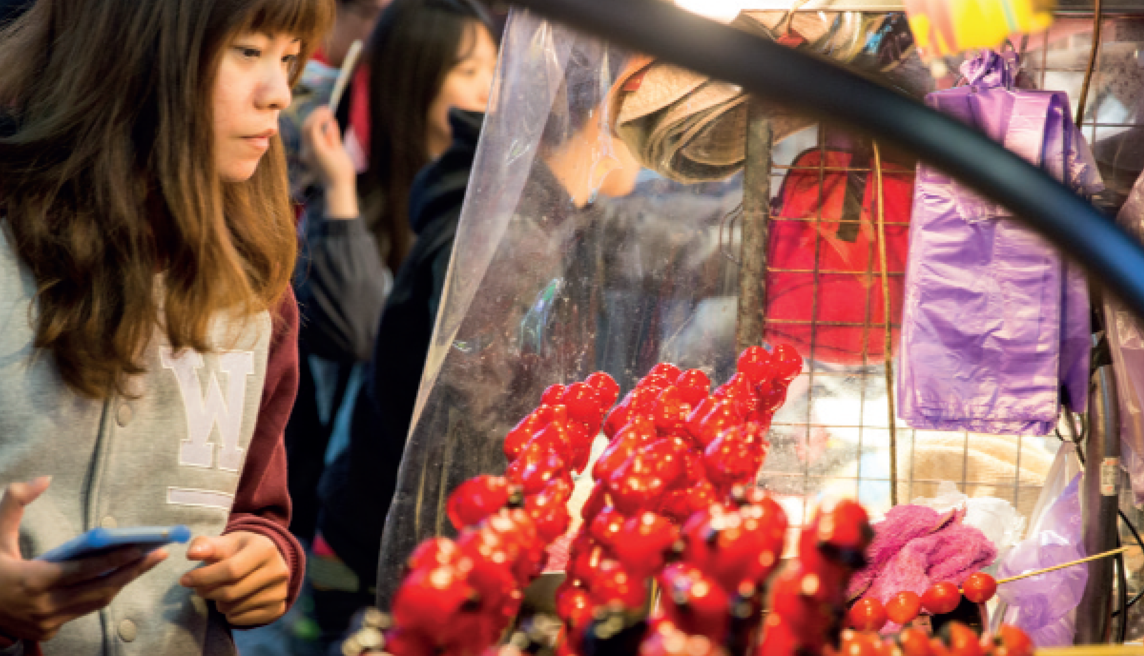
3 Frank Rossellini
When I was a child, my parents always promised to take me to Sicily one day. Finally, when they are both in their eighties, we have managed to get here. In this tiny village, we sit down to a dinner with lots of aunts, uncles and cousins. Eating together is still the most important part of the day here. After enormous plates of sausage, pasta, salads and homemade bread, everyone enjoys telling us stories of the friends and family members who left for New York decades earlier. It feels great to be here and I think about coming back again in the future.
8a-p. 94

Slide 11
Reading
3 Look at the photo with the article. Which of these things (a– c) do you think it shows?
1 Lucy Chang is from Taiwan originally, but her home is London; her destination is Taipei
Liz Mullan is from Canada; her destination is Belfast Frank Rossellini is from New York; his destination is Sicily
a a coastline
b a market
c a village
4 Read the article and answer the questions.
1 Where are the writers from and what are their destinations?
2 Which writers haven’t been to these places before?
3 Which writer has problems with the language?
4 Which writer travels with his/her parents?
5 Which writer has to change his/her plans? Why?
2 Lucy Chang and Frank Rossellini
3 Lucy Chang
4 Frank Rossellini
5 Liz Mullan (she planned to walk along the coast but it was raining hard)
8a-p. 94

Slide 12
5 Which activities in Exercise 2 did the three writers do?
Lucy Chang: 3 having new experiences (also, arguably, 2 going sightseeing, as she visits a famous night market)
Liz Mullan: 2 going sightseeing, as they go to the Giant’s Causeway; 1 taking it easy – they decide to find a cafe and hot food; (students may say 4 being active – but, although they plan a walk, they don’t actually do it)
Frank Rossellini: 6 spending time with family; (also, 1 taking it easy)
8a-p. 94

Slide 13
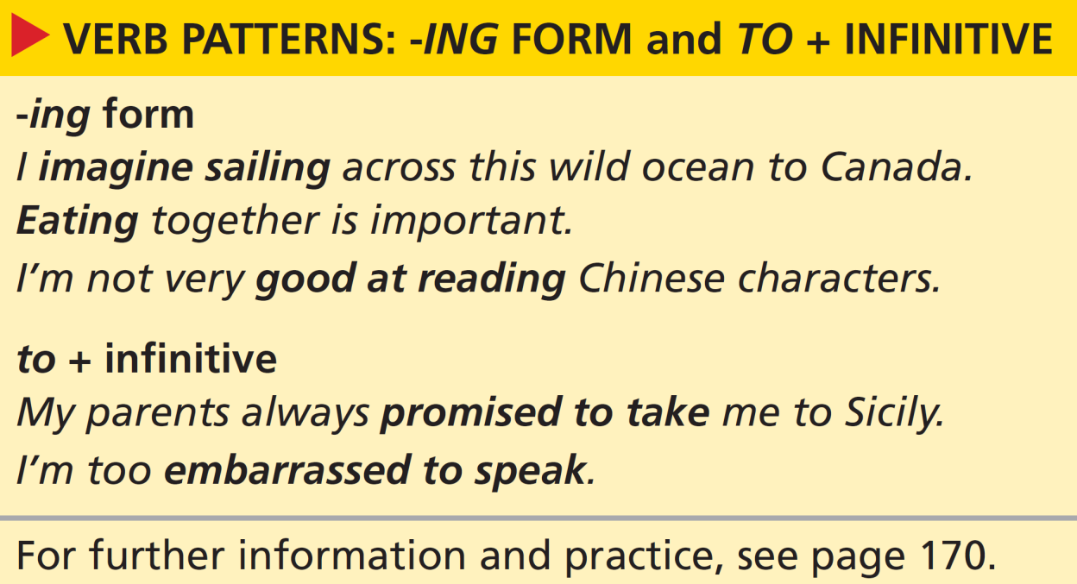

Grammar verb patterns: -ing form and to + infinitive
8a-p. 95

Slide 14
6 Look at the grammar box. Choose the correct option to complete these sentences. Then find an example of each use in the article.
1 We use the -ing form of the verb after certain verbs, as the subject of a sentence and after adjectives / prepositions.
2 We use to + infinitive form of the verb after certain verbs and after adjectives / prepositions.
Examples of -ing form in the article after certain verbs: imagine sailing, enjoys telling
as the subject of a sentence: Arriving, Eating together
after prepositions: good at reading, in spite of being, think about coming back
Examples of to + infinitive after certain verbs: learned to say, planned to walk, decide to find, promised to take, managed to get
after adjectives: embarrassed to speak, great to be
8a-p. 95

Slide 15
7 Each option in these sentences is grammatically possible but one option isn’t true, according to the article. Which one?
1 Lucy Chang described / finished / mentioned going to the market.
2 Lucy Chang needs / manages / wants to speak Chinese.
3 Liz Mullan adores / avoids / loves going to Ireland.
4 Liz Mullan expected / intended / threatened to walk along the coast.
5 Frank Rossellini’s parents planned / refused / wanted to travel to Sicily.
6 Frank Rossellini fails / hopes / intends to return to the village.
8a-p. 95

Slide 16
8 Choose the correct option to complete the sentences. Then work in pairs. Tell your partner which sentences you agree with.
1 Travelling / To travel by train is usually pleasant.
2 Good hotels are easy finding / to find.
3 Cycling / To cycle can be a good way of seeing a new city.
4 Sleeping / To sleep on a plane can be difficult.
5 Some hotels are too expensive staying / to stay in.
6 I’m interested in trying / to try new things on holiday.
7 Going / To go on holiday with friends is always fun.
8 I get fed up with spending / to spend every day on the beach.
1 (subject of the sentence)
2 (after an adjective)
3 (subject of the sentence)
4 (subject of the sentence)
5 (after an adjective)
6 (after a preposition)
7 (subject of the sentence)
8 (after a preposition; fed up with = bored with)
8a-p. 95

Slide 17
9 Complete the conversation with the -ing form and to + infinitive form of the verbs. Then listen and check.
Track 63
Rose: Hi there, I’m Rose.
Matt: Hi, I’m Matt.
Rose: Is this your first time in Corfu?
Matt: No, actually. We come every year. We love 1 ___________ (stay) here.
Rose: So do we. We keep 2 ___________ (come) back year after year. It’s hard
3 ___________ (find) somewhere with everything you need for a holiday – great beaches, fantastic weather and something for everyone to do.
Matt: I know. Actually, there’s a paragliding class later – I fancy 4 _________ (try) that.
Rose: My friends want 5 ___________ (do) that too! To be honest,
6 ___________ (lie) by the pool is my idea of a holiday.
Matt: Oh, I get a bit bored with 7 ___________ (do) that after the first day or two. I need 8 ___________ (move) around and do things.
Rose: Well, why not? It’s a different way of 9 ___________ (relax), I suppose.
Matt: Yes, that’s right. Well, if you decide 10 ___________ (go) paragliding with your friends, we’ll see you there!
staying
coming
to find
trying
to do
lying
doing
to move
relaxing
to go
8a-p. 95

Slide 18
Script
Track 63
R = Rose, M = Matt
R: Hi there, I’m Rose.
M: Hi, I’m Matt.
R: Is this your first time in Corfu?
M: No, actually. We come every year. We love staying here.
R: So do we. We keep coming back year after year. It’s hard to find somewhere with everything you need for a holiday – great beaches, fantastic weather and something for everyone to do.
M: I know. Actually, there’s a paragliding class later – I fancy trying that.
R: My friends want to do that too! To be honest, lying by the pool is my idea of a holiday.
M: Oh, I get a bit bored with doing that after the first day or two. I need to move around and do things.
R: Well, why not? It’s a different way of relaxing, I suppose.
M: Yes, that’s right. Well, if you decide to go paragliding with your friends, we’ll see you there!

Slide 19

Listening and speaking
10 Listen to people talking about holidays and complete the sentences. Do you think they would be good holiday companions for you? Which person would you prefer to go on holiday with?
Track 64
1 I enjoy … .
2 I quite fancy … .
3 I don’t mind … .
4 I’d like … .
5 I can’t afford … .
6 I’m quite keen on … .
7 I don’t like … .
8 I’m interested in … .
9 I can’t stand … .
10 I’m happy … .
1 I enjoy doing lots of sports.
2 I quite fancy trying extreme sports.
3 I don’t mind walking long distances.
4 I’d like to see somewhere spectacular.
5 I can’t afford to go away for more than a week.
6 I’m quite keen on visiting historical places.
7 I don’t like sleeping outdoors.
8 I’m interested in learning other languages.
9 I can’t stand being in the sun.
10 I’m happy to share a room.
8a-p. 95

Slide 20
11 Think about how you would complete the sentences in Exercise 10. Then talk to people in your class and find someone who would make a good holiday companion.
12 Work with your holiday companion and decide what kind of holiday to have. Tell the class:
• where and when you would go
• how you’d get there
• where you’d stay
• what you’d do there and why
8a-p. 95

